Slide 1
Project 5: TellCo Telecom User Analytics
Sayali Patil

Slide 2
Project Architecture & Key Highlights
Total Customer Base
Analyzed data across 89,700 unique telecom customers with comprehensive session tracking.
148,935
Traffic Concentration
TOTAL SESSIONS CAPTURED
Gaming and Other traffic overwhelmingly dominate overall data usage (over 120T Bytes combined).
73,833.16 GB
TOTAL AGGREGATE DATA TRAFFIC
Machine Learning Segmentation
Engineered Engagement, Experience, and Satisfaction clusters using K-Means Clustering.

Slide 3

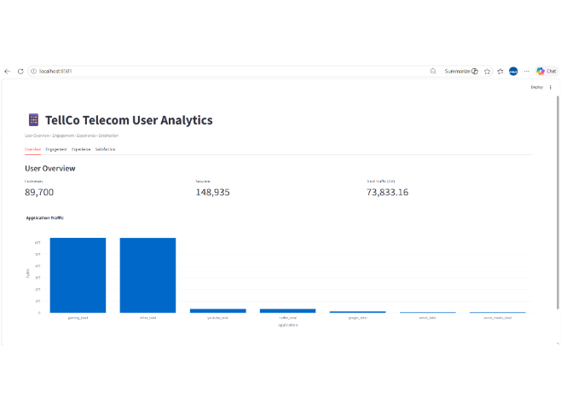
Customer Scale & Traffic Distribution
Headline Metrics
• 89,700 active customers
• 148,935 user sessions
• 73,833.16 GB total network payload
Application Insights
Gaming and Other represent peak bandwidth usage. YouTube, Netflix, Google, Email, and Social Media follow with significantly lower volumes.
Business Impact
Infrastructure optimization should prioritize high-throughput gaming protocols to preserve quality of service.

Slide 4
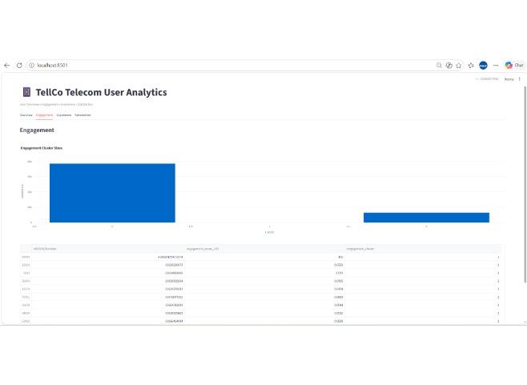
User Engagement Clustering & Scoring
Engagement Clusters
Users segmented based on session frequency, duration, and session traffic using K-Means clustering.
Cluster Distribution
• Cluster 0 (Primary): Regular baseline users (~78k customers)
• Cluster 2 (Power Users): High engagement cohort (~11k customers)
Key Action
Target Cluster 2 power users with tailored high-bandwidth loyalty plans.

Slide 5
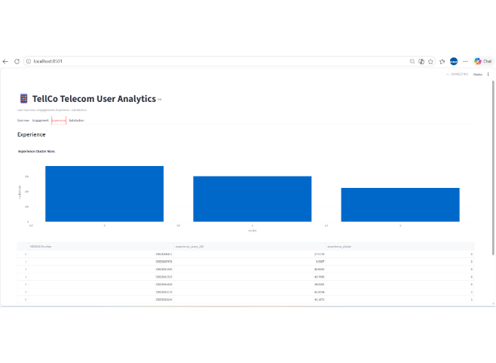
Network Experience & Quality Metrics
Network Telemetry
Evaluated throughput, round-trip time (RTT), and TCP retransmission rates across customer devices.
Experience Clusters
• Cluster 0: High quality / low latency (~35k customers)
• Cluster 1: Moderate network performance (~30k customers)
• Cluster 2: Network degradation issues (~22k customers)
Optimization Target
Investigate Cluster 2 device types and cell towers to resolve latency bottlenecks.

Slide 6
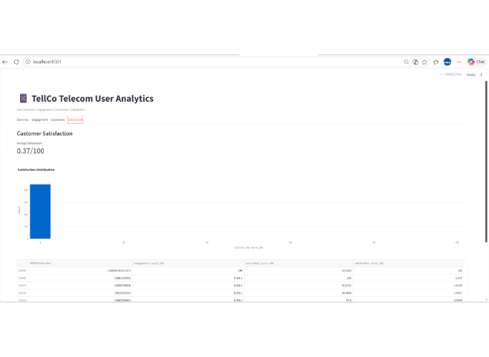
Engagement & Experience Combination Score
Satisfaction Index
Combined Engagement Score and Experience Score via Euclidean distance modeling to assign satisfaction values.
Overall Average Score
0.37 / 100 — Highlights significant potential to uplift overall network satisfaction by improving low-performing clusters.
Strategic Goal
Convert low-satisfaction accounts into loyal users through targeted network upgrades.

Slide 7
Conclusion
The TellCo Telecom User Analytics dashboard provides a clear starting point for understanding customer scale, session activity and application-level traffic.
Value delivered
Consolidates high-level metrics in one interface.
Makes traffic concentration easier to spot.
Creates a navigable structure for engagement, experience and satisfaction analysis.
Thank you

